Slide 1
SQL Challenge 1
Challenge 1 - Steve's Car Showroom

Slide 2
Steve runs a top-end car showroom but his data analyst has quit and left him without the crucial insights .
Here, I’m analyzed three tables to provide him all the answers he required about the car showroom.
The case study consists of 3 tables, namely:
1. Sales
2. Cars
3. Salespersons

Slide 3
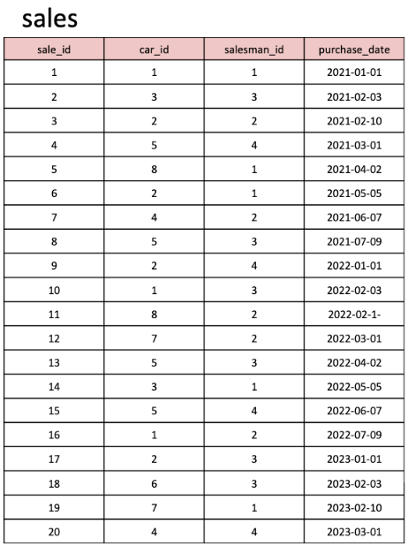
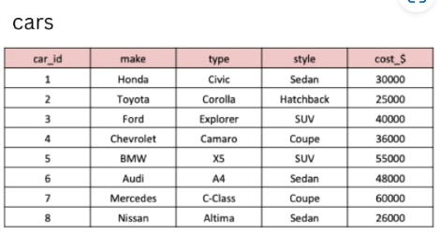
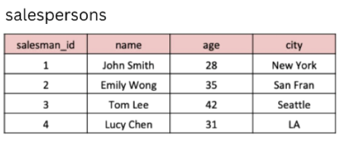
Tables used for analysis

Slide 4
SQL Schema:
CREATE TABLE cars ( car_id INT PRIMARY KEY, make VARCHAR(50), type VARCHAR(50), style VARCHAR(50), cost_$ INT );
INSERT INTO cars (car_id, make, type, style, cost_$) VALUES (1, 'Honda', 'Civic', 'Sedan', 30000), (2, 'Toyota', 'Corolla', 'Hatchback', 25000), (3, 'Ford', 'Explorer', 'SUV', 40000), (4, 'Chevrolet', 'Camaro', 'Coupe', 36000), (5, 'BMW', 'X5', 'SUV', 55000), (6, 'Audi', 'A4', 'Sedan', 48000), (7, 'Mercedes', 'C-Class', 'Coupe', 60000), (8, 'Nissan', 'Altima', 'Sedan', 26000);

Slide 5
CREATE TABLE salespersons ( salesman_id INT PRIMARY KEY, name VARCHAR(50), age INT, city VARCHAR(50) );
INSERT INTO salespersons (salesman_id, name, age, city) VALUES (1, 'John Smith', 28, 'New York'), (2, 'Emily Wong', 35, 'San Fran'), (3, 'Tom Lee', 42, 'Seattle'), (4, 'Lucy Chen', 31, 'LA’);
CREATE TABLE sales ( sale_id INT PRIMARY KEY, car_id INT, salesman_id INT, purchase_date DATE, FOREIGN KEY (car_id) REFERENCES cars(car_id), FOREIGN KEY (salesman_id) REFERENCES salespersons(salesman_id) );

Slide 6
INSERT INTO sales (sale_id, car_id, salesman_id, purchase_date) VALUES (1, 1, 1, '2021-01-01'), (2, 3, 3, '2021-02-03'), (3, 2, 2, '2021-02-10'), (4, 5, 4, '2021-03-01'), (5, 8, 1, '2021-04-02'), (6, 2, 1, '2021-05-05'), (7, 4, 2, '2021-06-07'), (8, 5, 3, '2021-07-09'), (9, 2, 4, '2022-01-01'), (10, 1, 3, '2022-02-03'), (11, 8, 2, '2022-02-10'), (12, 7, 2, '2022-03-01'), (13, 5, 3, '2022-04-02'), (14, 3, 1, '2022-05-05'), (15, 5, 4, '2022-06-07'), (16, 1, 2, '2022-07-09'), (17, 2, 3, '2023-01-01'), (18, 6, 3, '2023-02-03'), (19, 7, 1, '2023-02-10'), (20, 4, 4, '2023-03-01');

Slide 7

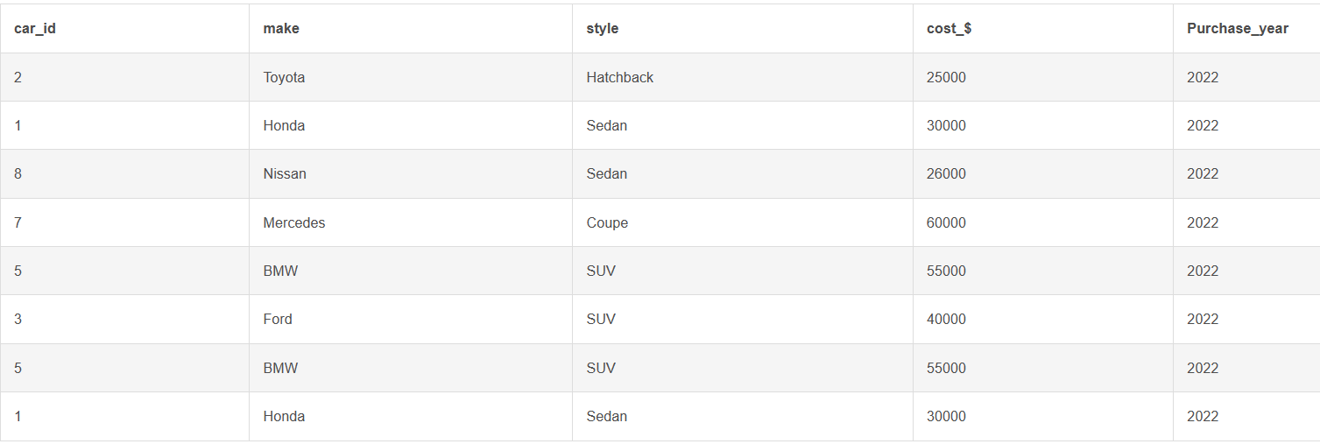
SQL Query:
What are the details of all cars purchased in the year 2022?

Slide 8
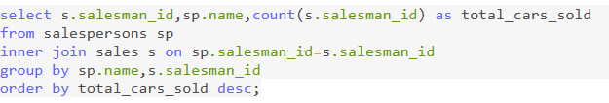
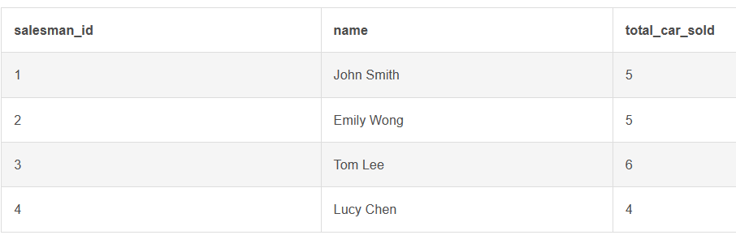
2. What is the total number of cars sold by each salesperson?

Slide 9
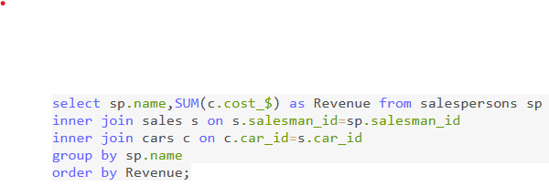
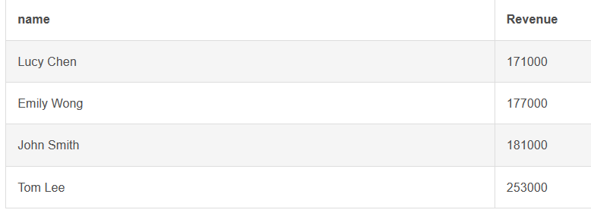
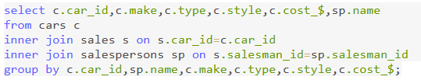
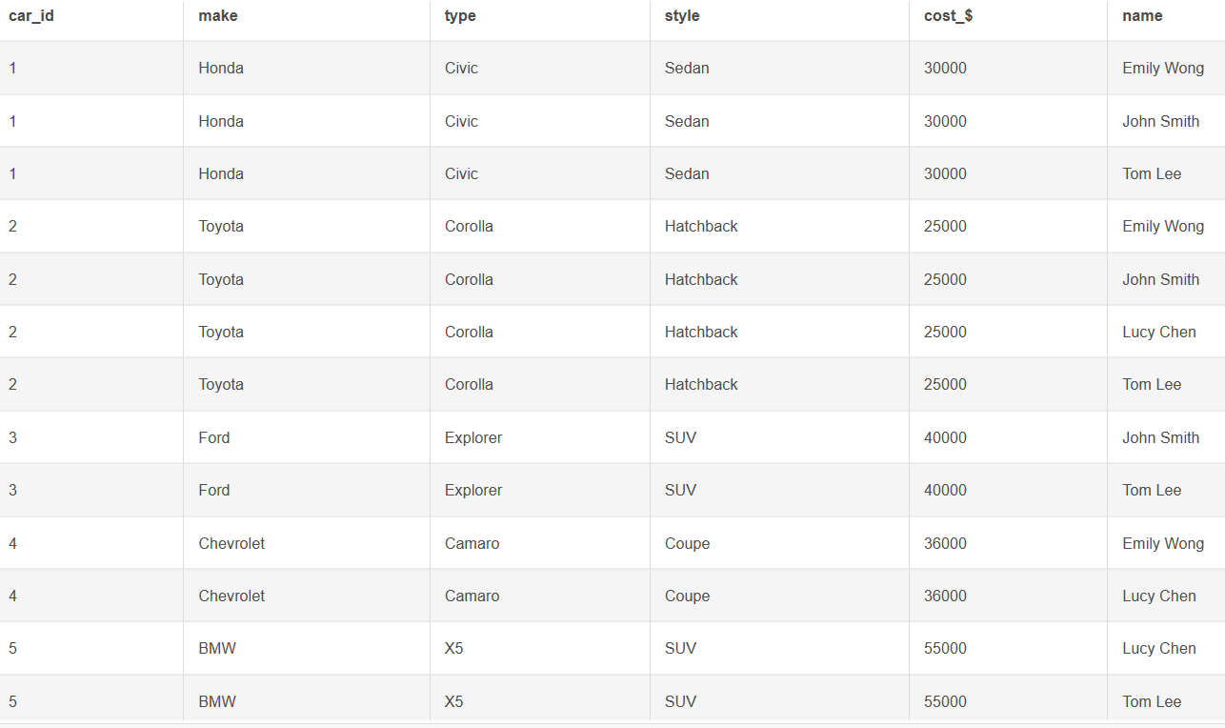
What is the total revenue generated by each salesperson?
4. What are the details of the cars sold by each salesperson?

Slide 10
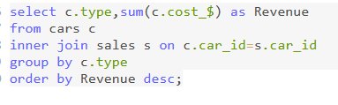
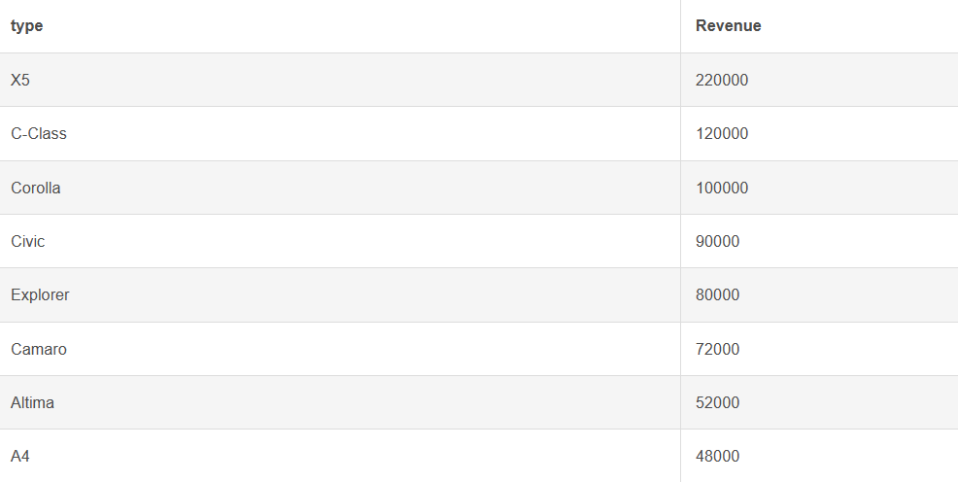
5. What is the total revenue generated by each car type?

Slide 11
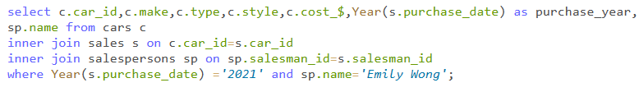
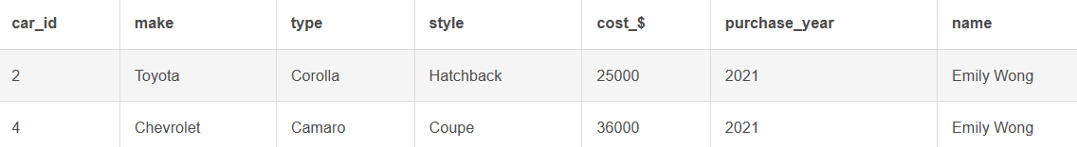
6. What are the details of the cars sold in the year 2021 by salesperson 'Emily Wong’?

Slide 12
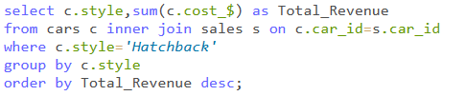
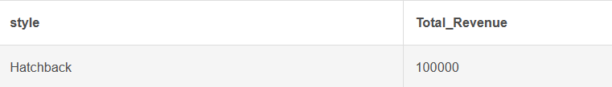

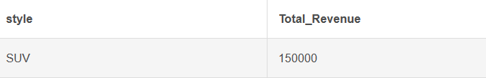
What is the total revenue generated by the sales of hatchback cars?
What is the total revenue generated by the sales of SUV cars in the year 2022?

Slide 13
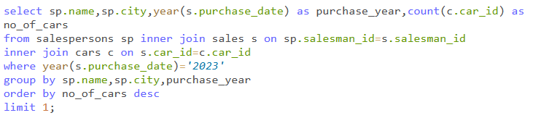
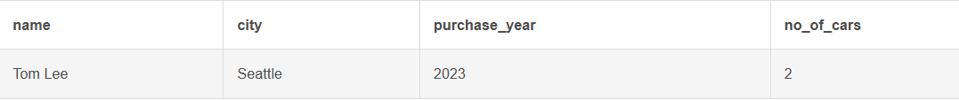
What is the name and city of the salesperson who sold the most number of cars in the year 2023?

Slide 14
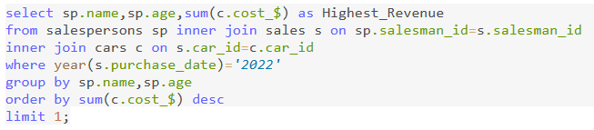

10. What is the name and age of the salesperson who generated the highest revenue in the year 2022?

Slide 15
Key Insights
Total 8 cars are purchased in the year 2022 (where Honda & BMW are most purchased).
Tom Lee from Seattle sold highest number of cars in the year 2023 and also he generated the highest revenue from the sales.
BMW X5 type cars are generated the highest revenue which is 220000.
Total revenue generated by the sales of hatchback car is 100000.
Emily Wong generated highest no. of revenue in the year 2022 which is 116000.
the total revenue generated by the sales of SUV cars in the year 2022 is 150000.

Slide 16
THANK YOU

